Slide 1
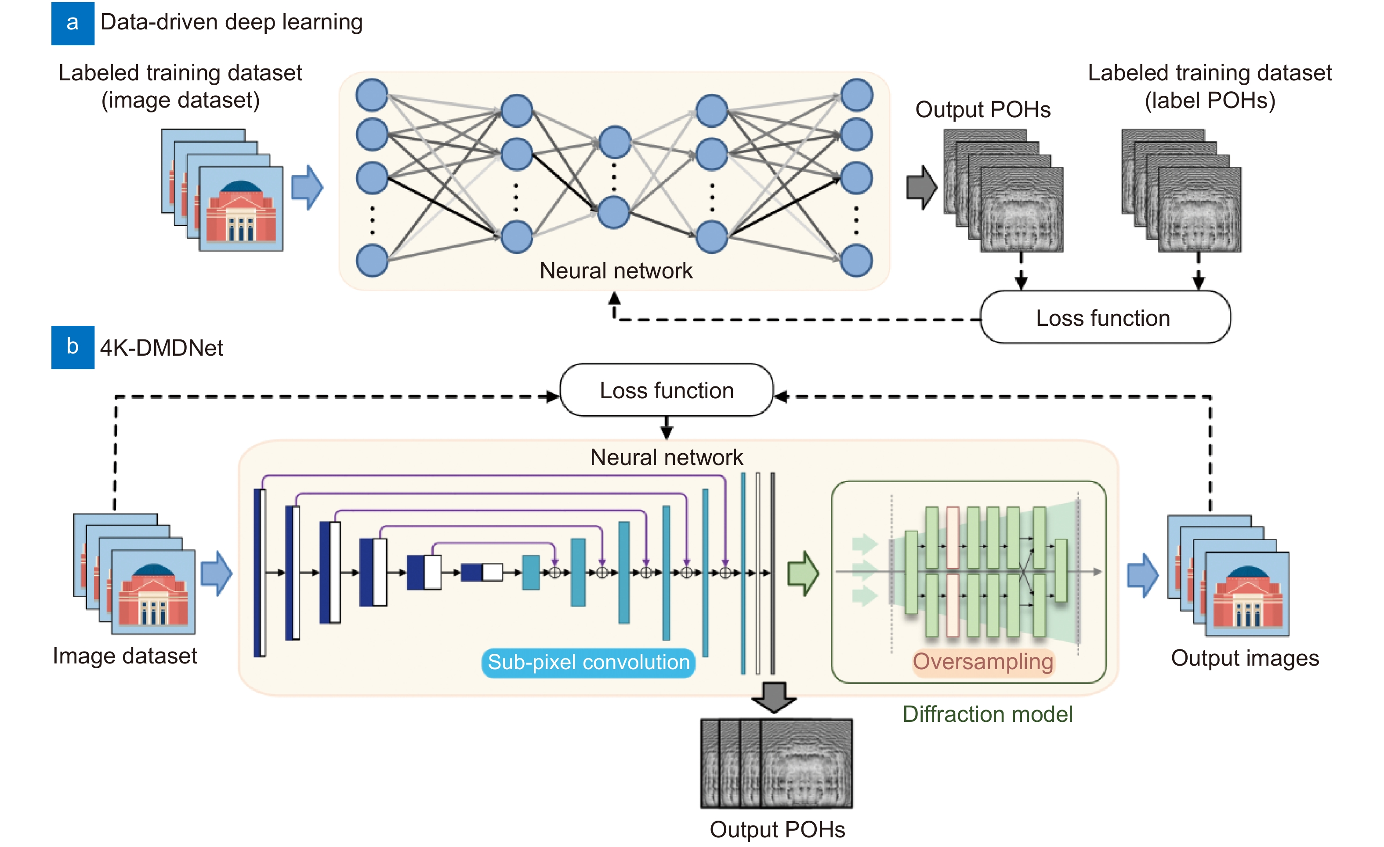
Figure 1. Training processes of (a) data-driven deep learning and (b) 4K-DMDNet, respectively.
Kexuan Liu,Jiachen Wu,Zehao He,Liangcai Cao
4K-DMDNet: diffraction model-driven network for 4K computer-generated holography
https://doi.org/10.29026/oea.2023.220135

